Slide 1

Title slide

Slide 2

Title slide

Slide 3

Title slide

Slide 4

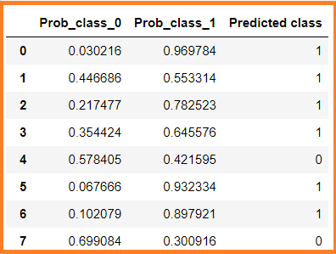
Title slide

Slide 5

Title slide

Slide 6
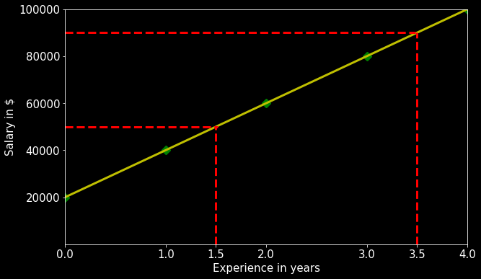
Recall the Regression Line
Title slide

Slide 7
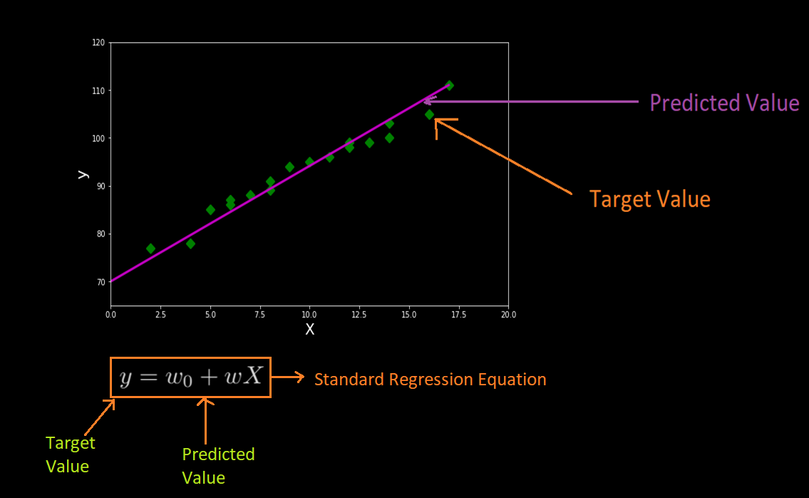
Title slide

Slide 8
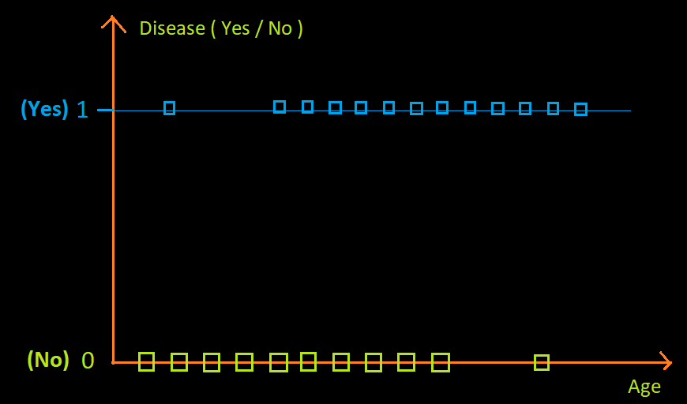
Title slide

Slide 9
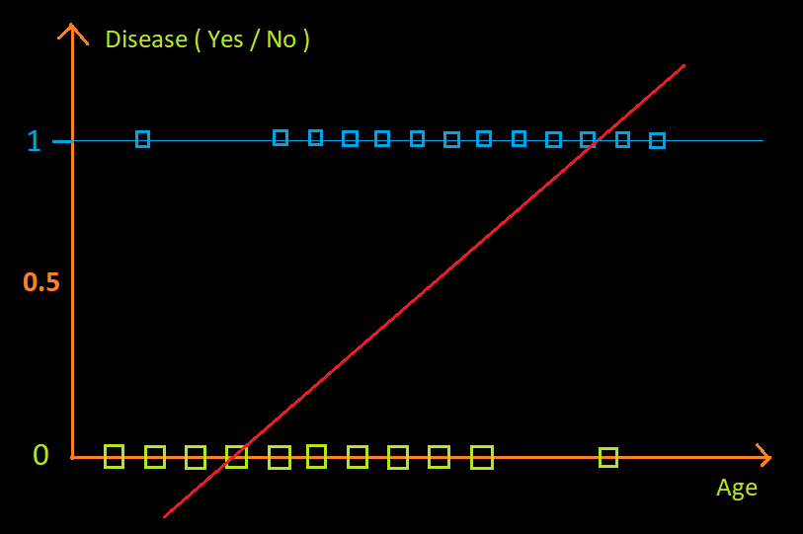
Title slide

Slide 10
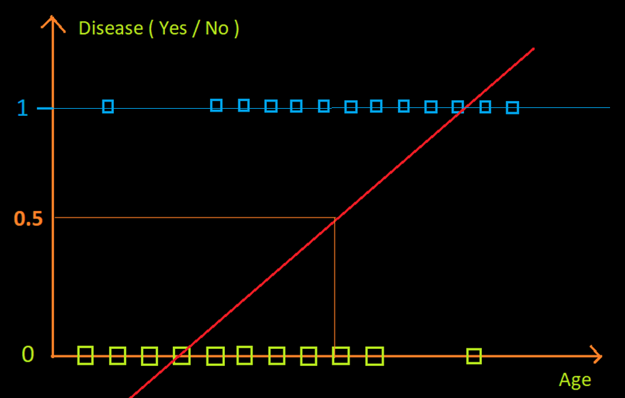
Title slide

Slide 11
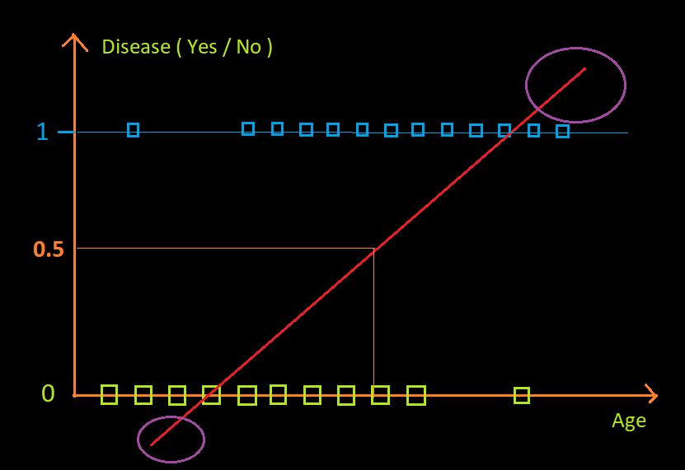
Title slide

Slide 12
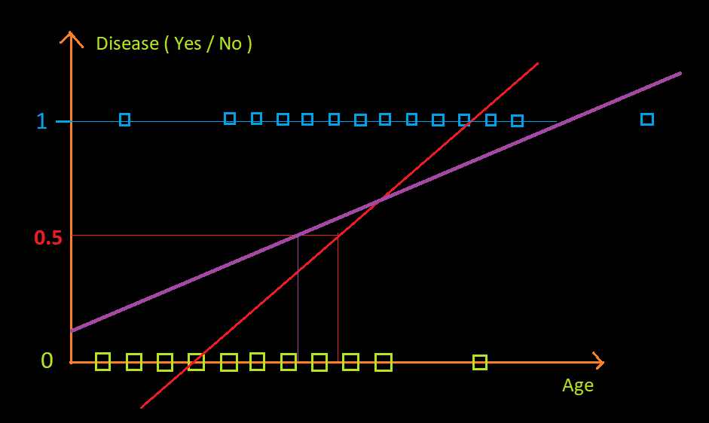
Title slide

Slide 13
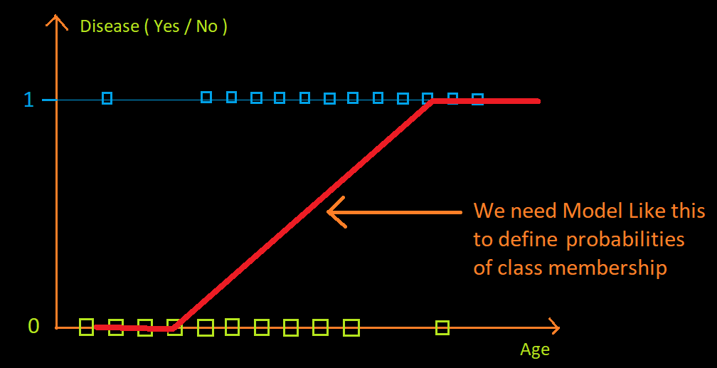
Title slide

Slide 14

Title slide

Slide 15
Title slide

Slide 16
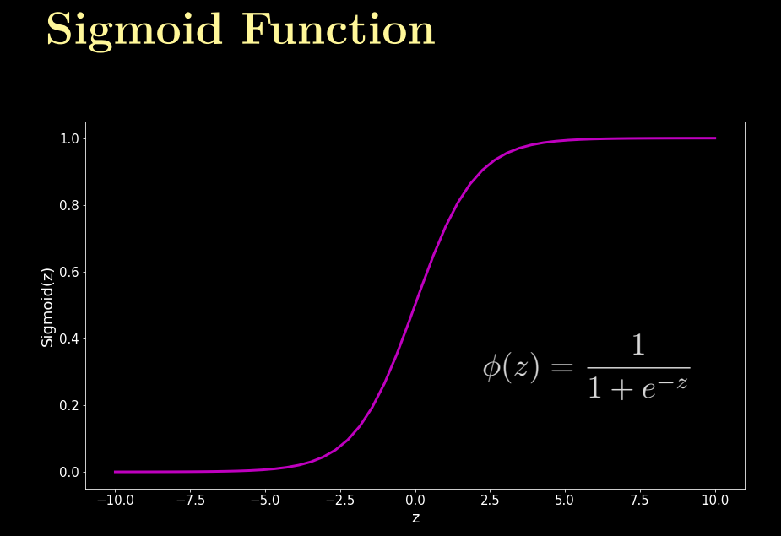
Title slide

Slide 17

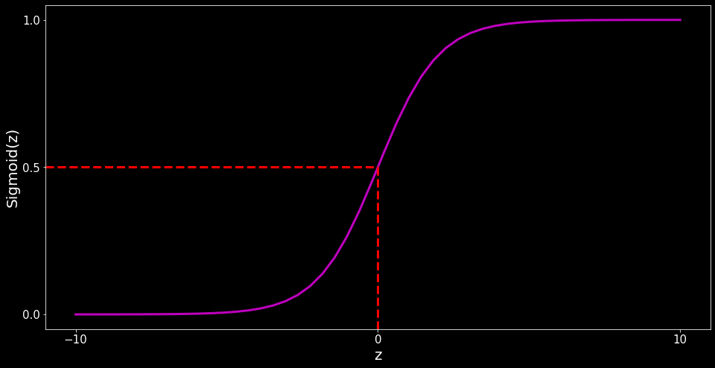
Title slide

Slide 18
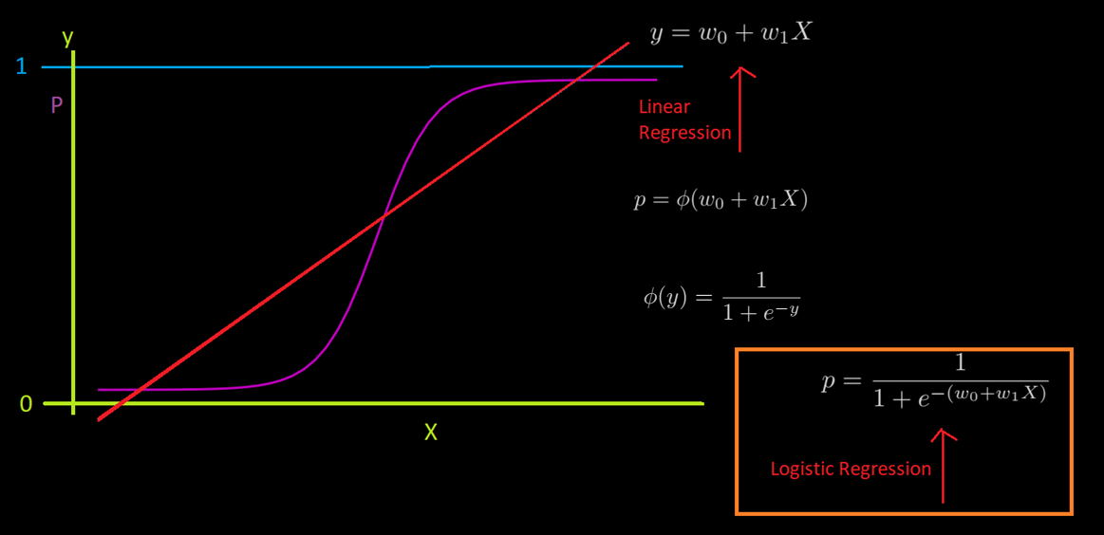
Title slide

Slide 19
Title slide

Slide 20
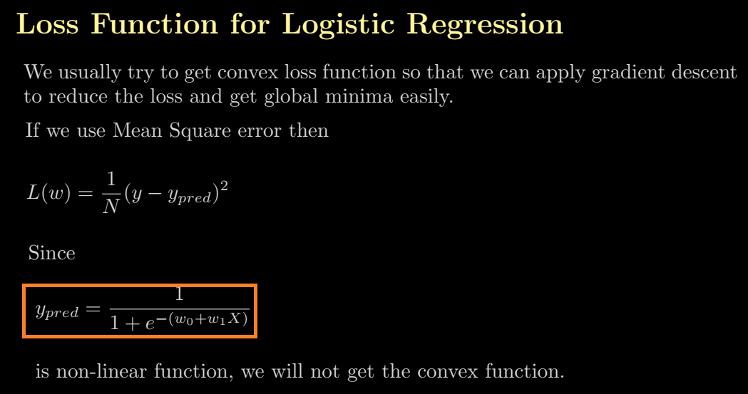
Title slide

Slide 21
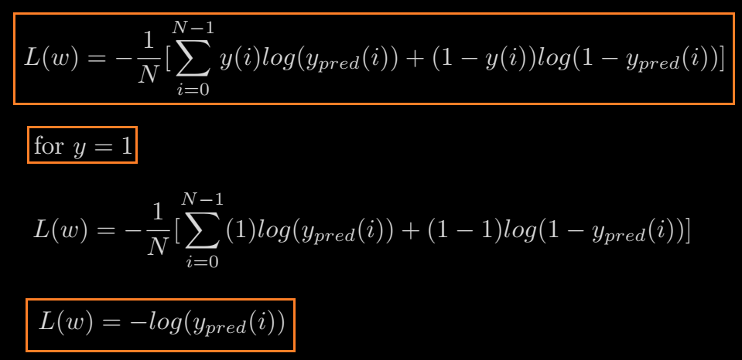
Title slide

Slide 22
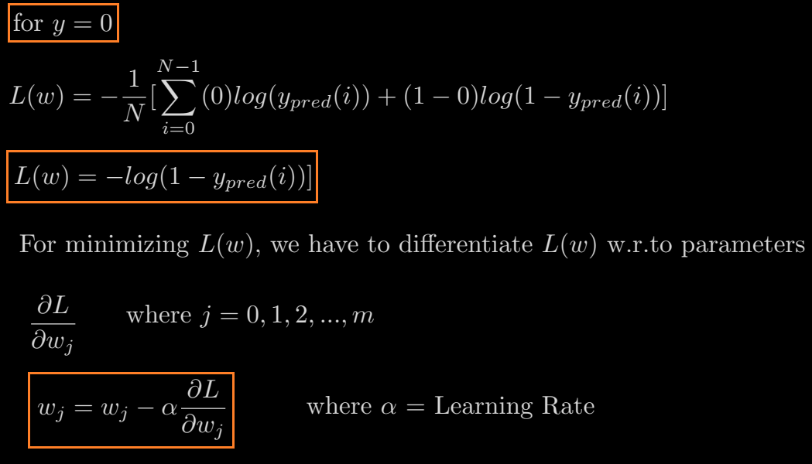
Title slide

Slide 23

Title slide

Slide 24

Title slide

Slide 25

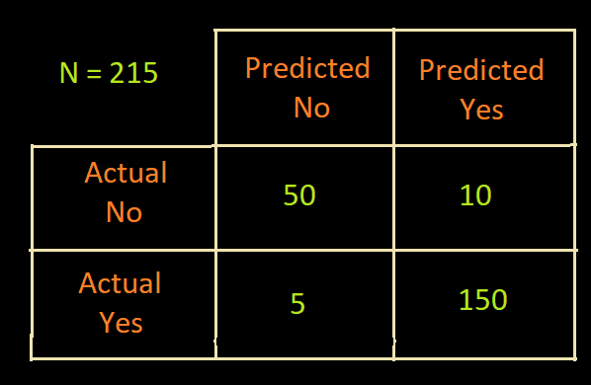
Title slide

Slide 26


Title slide

Slide 27
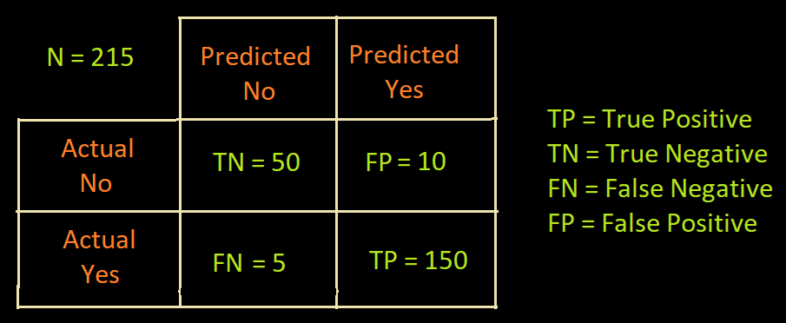
Title slide

Slide 28

Title slide

Slide 29

Title slide

Slide 30
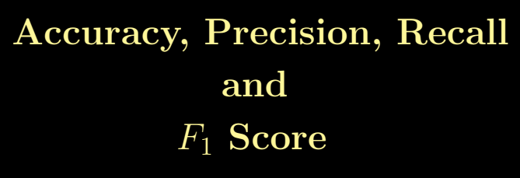
Title slide

Slide 31

Title slide

Slide 32
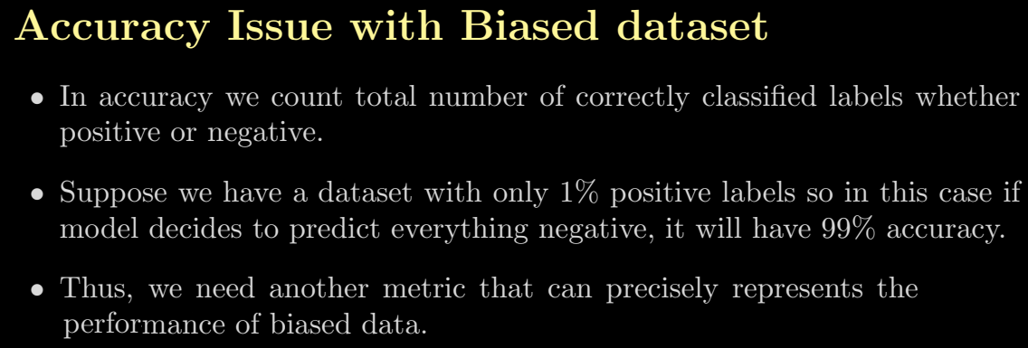
Title slide

Slide 33

Title slide

Slide 34
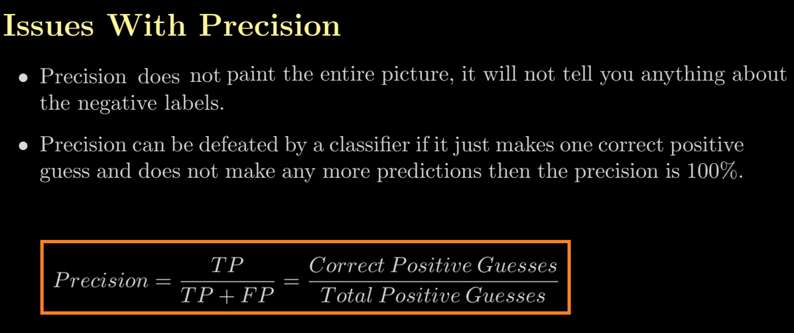
Title slide

Slide 35
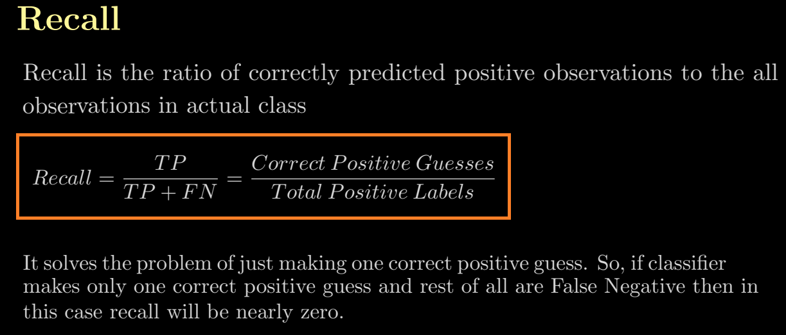
Title slide

Slide 36



Title slide

Slide 37
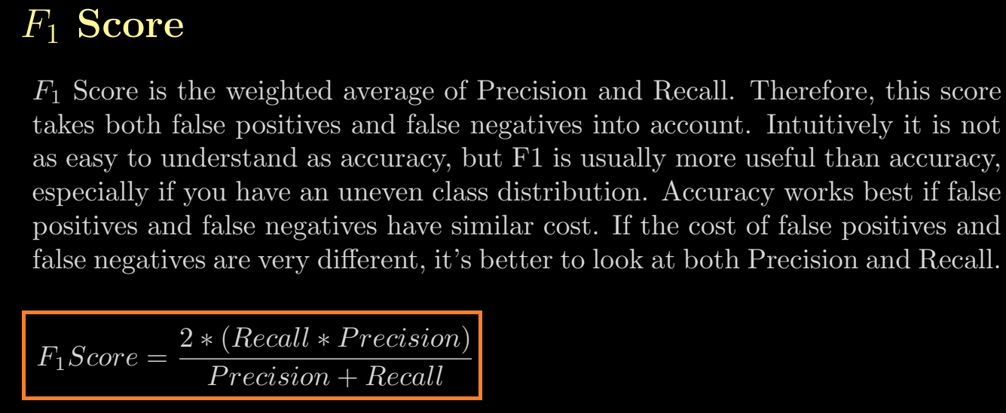
Title slide

Slide 38

Title slide

Slide 39
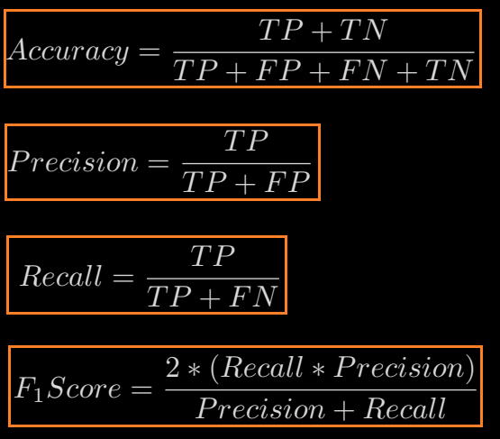
Title slide

Slide 40

Title slide

Slide 41


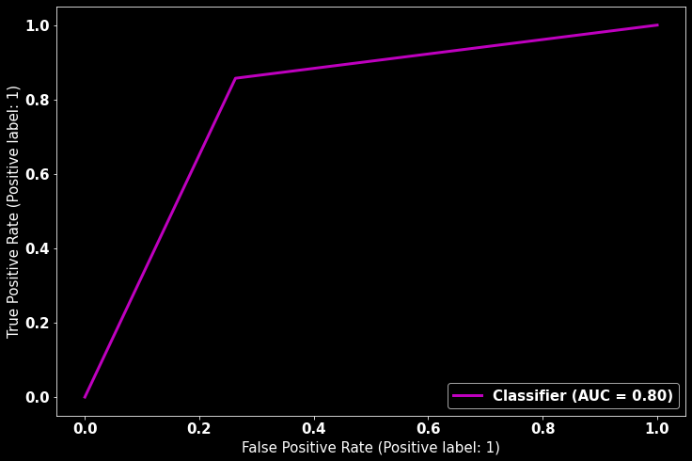
Title slide

Slide 42
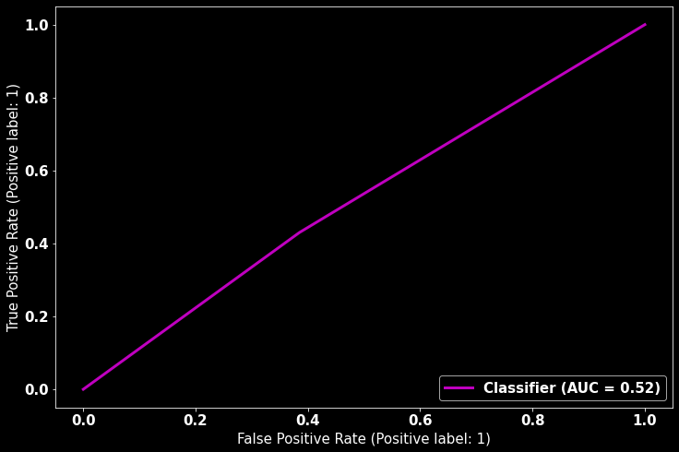
Title slide

Slide 43
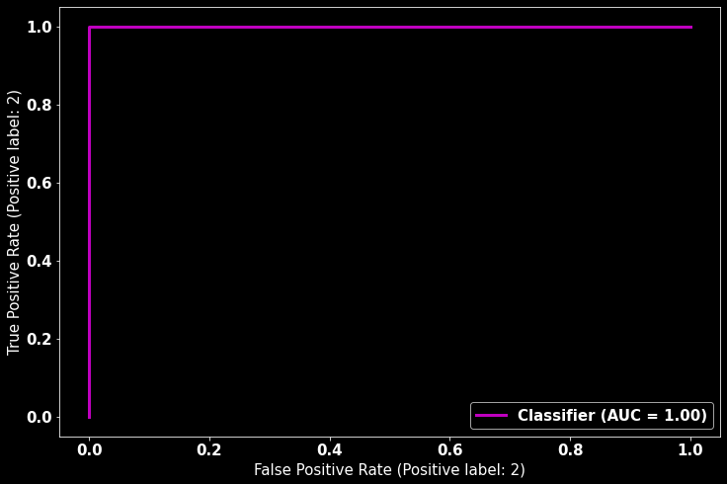
Title slide

Slide 44
Title slide
Thank you!

